Slide 1
Welcome to the NJTSS Early Reading Project!
Funded by the U.S. Department of Education, OSEP

Slide 2
Rationale for New Jersey Tiered System of Supports for Early Reading (NJTSS-ER)
Majority of students with reading difficulties in 3rd grade continue to be poor readers in 9th grade (e.g., Francis et al., 1996)
Identifying all students’ needs and intervening early is critical to ensuring students’ success in school (Torgesen, 2009; Wanzek & Vaughn, 2007) and to promoting social justice
Multi-tiered systems of reading support have been found to reduce student reading difficulties and increase reading performance (Glover, 2016; Wanzek & Vaughn, 2007)

Slide 3
NJTSS in Early Reading
Designed to provide district support in…
Implementing a systems approach to integrating core support and interventions within a school based on a continuum of student needs
Using student data to identify the effectiveness of core implementation and additional intervention needs
Regularly evaluating students’ progress and implementing a plan for adjusting instruction/intervention based on needs

Slide 4
New Jersey Tiered System of Supports
Leadership is provided via teams with multiple stakeholders (e.g., Administrators, Teachers Interventionists)
Student data are used to…
Evaluate the effectiveness of programs/ instruction
ID students’ needs
Determine placement into intervention
Monitor students’ progress in response to intervention
A continuum of research-based practices are provided across tiers of service
TIER 3 – INTENSIVE INTERVENTIONS
TIER 2 – SMALL TARGETED
GROUP INTERVENTIONS
TIER 1 – CORE INSTRUCTION/
PROGRAM
Data-based decisions

Slide 5
Systems Levels for Training & Implementation
State-Level PD/Coaching
Teacher/Staff Implementation
Increased Student Achievement
School Leadership (Team-based)
District Leadership (Team-based)/Coaching

Slide 6
Cohort Progression for Professional Development
 | Year 1 | Year 2 | Year 3 | Year 4 | Year 5
Cohort 1: 20 Schools | Stage 1 | Stage 2 | Stage 3 | Sustain Practices | Sustain Practices
Cohort 2: 20 Schools |  | Stage 1 | Stage 2 | Stage 3 | Sustain Practices
Cohort 3: 20 Schools |  |  | Stage 1 | Stage 2 | Stage 3

Slide 7
Year 1 Priorities
Foundations for NJTSS-ER
Early prevention
Multi-tiered support framework
Stakeholder roles, team leadership
Structural considerations
Identifying student needs
Research-based reading assessments
Selection and administration of screening approaches
Interpreting screening for differentiation of instruction
Introduction to best practices for reading instruction
Research-based components of reading
Effective core reading curriculum and instruction
Evaluating/mapping core curriculum
Application of criteria for effective implementation

Slide 8
Year 2 Priorities
Student assessment and data-based decisions
Screening & skill-based grouping, establishing student goals, monitoring implementation & student performance, adjusting instruction based on students’ progress
Targeted & intensive reading interventions
Characteristics of effective interventions, intervention selection, personnel involvement/scheduling

Slide 9
Year 3 Priorities
Full NJTSS-ER implementation
Data review, core considerations, & student intervention grouping
Refinement of assessment & intervention inventories
Monitoring fidelity & student progress
Maximizing students’ response to intervention

Slide 10
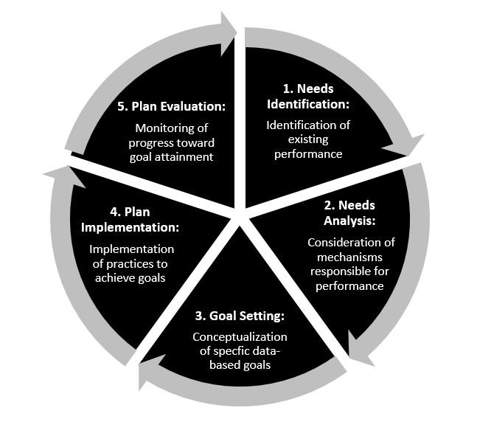
Five-Phase Sequence for Data-Driven Instructional Coaching Model

Slide 11
Additional Support from Partners
NJ Principals and Supervisors Association (NJPSA)
Statewide Parent Advocacy Network (SPAN)
Support district/school family & community engagement liaisons

